Slide 1
Capstone Project - 4
Netflix Movies and TV Shows Clustering
Team Members
1 Arvind Kale
2 Priyanka Jain
3 Mohd Sakib Quraishi
4 Nitish kumar

Slide 2
Introduction
Problem Statement
Data Description
Null Value
Exploratory Data Analysis
Data Cleaning
Topic modelling
Model Implementation
Data Pre-processing
Model Implementation
K- Means
Cluster Analysis

Slide 3
Introduction
:
Netflix is a media distribution company. It started with DVD distribution via mail, but has evolved substantially over the course of its existence. Today, Netflix is focused on streaming video. Some of its content is licensed, and some of the content is produced in-house. Netflix originally focused on movies, but today television shows are probably the more common format. Netflix works on a subscription model, where users get unlimited access to content with a paid subscription.

Slide 4
Problem Statement
This dataset consists of tv shows and movies available on Netflix as of 2019. The dataset is collected from Flexible which is a third-party Netflix search engine.
In 2018, they released an interesting report which shows that the number of TV shows on Netflix has nearly tripled since 2010. The streaming services number of movies has decreased by more than 2,000 titles since 2010, while its number of TV shows has nearly tripled. It will be interesting to explore what all other insights can be obtained from the same dataset.
Integrating this dataset with other external datasets such as IMDB ratings, rotten tomatoes can also provide many interesting findings.
Let us try to solve.
In this project, you are required to do
Exploratory Data Analysis
Understanding what type content is available in different countries
Is Netflix has increasingly focusing on TV rather than movies in recent years.
Clustering similar content by matching text-based features

Slide 5

Data Description
The data was collected from Flexible which is third party Netflix
search engine. The dataset consists of movies and TV shows data till
2019. The dataset has 7787 rows of data.
The dataset consists of eleven textual columns and one numeric
Column.
Attribute Information :
show_id : Unique ID for every Movie / Tv Show
type : Identiﬁer - A Movie or TV Show
title : Title of the Movie / Tv Show
director : Director of the Movie

Slide 6
Data Description
5. cast : Actors involved in the movie / show
6. country : Country where the movie / show was produced
7. date_added : Date it was added on Netﬂix
8. release_year : Actual Release year of the movie / show
9. rating : TV Rating of the movie / show
10. duration : Total Duration - in minutes or number of seasons
11. listed_in : Genre
12. description: The Summary description

Slide 7
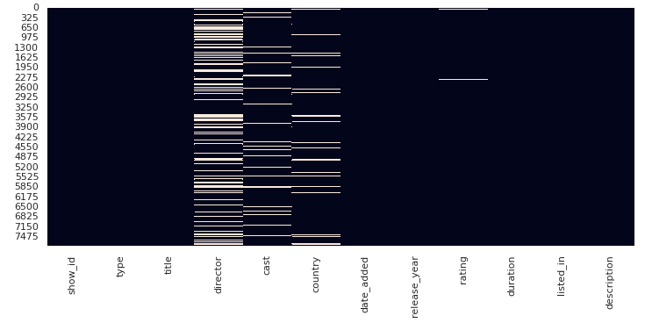
Null Value
Column director,cast,country and date_added contains null values.

Slide 8
Null Value Treatment:
Director feature have more than 30.68% of null values. Filling null values by ‘unknown’.
● Country feature have 6.51% of null values. Filling null values by mode of feature.
● Cast feature have 9.22% of null values. Filling null values by ‘unknown’.
● Rating feature have 0.09% of null values. Filling null values by mode of feature.
● Date_added feature have 0.13% of null values. Dropping rows corresponding to null values.

Slide 9
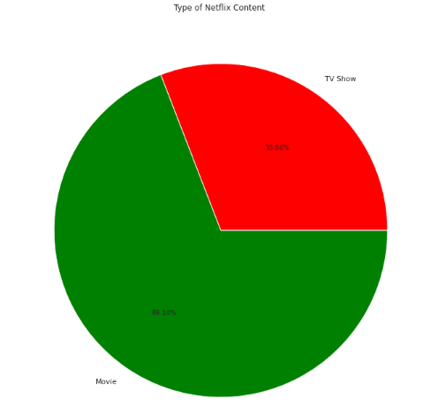
Exploratory Data Analysis
It is shows that there are more movies on Netflix than TV shows.

Slide 10
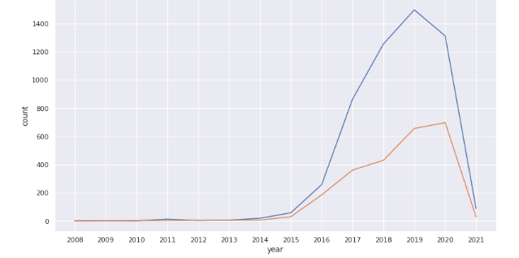
EDA on number of movie and tv show in a year
Blue- TV show
Orange- Movies
Growth in the number of movies on Netflix is much higher than tv shows
From 2015 we can see a noticeable addition in the number of movies and tv shows uploaded by Netflix on its platform.
.

Slide 11
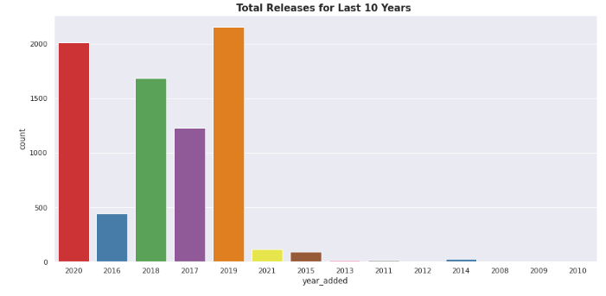
EDA ON Total release for last 10 years
The number of release have significantly increased after 2015 and have dropped in 2021
because of Covid 19

Slide 12
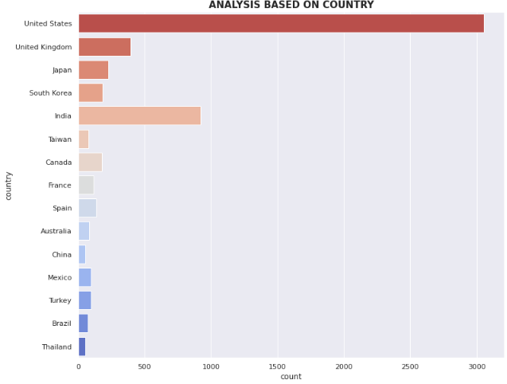
ANALYSIS Based ON country
United states have the most number of content
India have second highest content
on Netflix

Slide 13
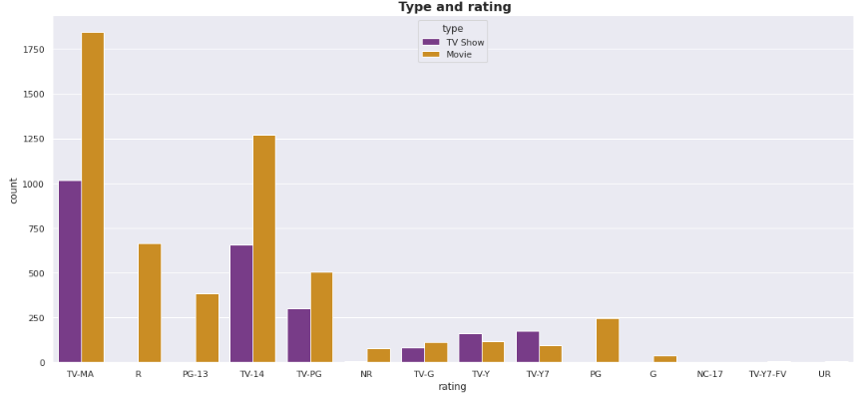
EDA On Rating wise content count

Slide 14
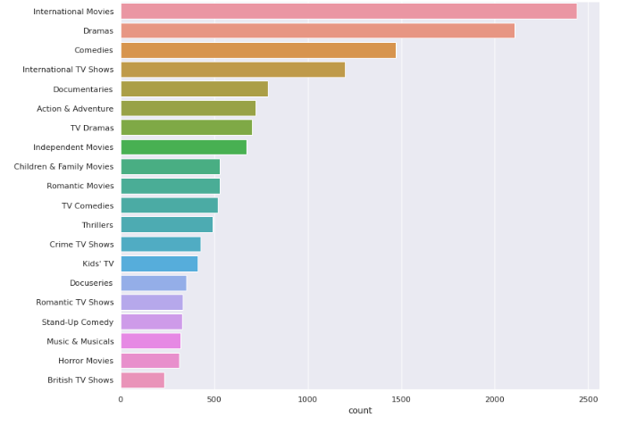
Content wise Analysis
International movies and drama has highest number of content

Slide 15
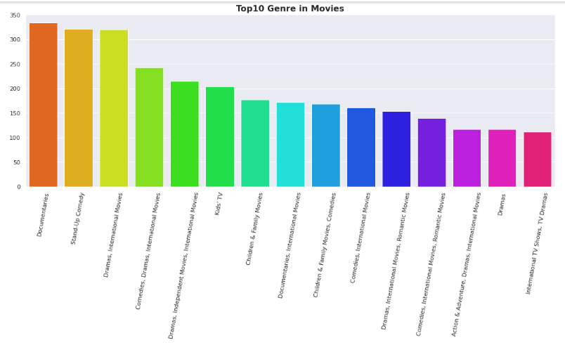
Top genre added in netflix
Drama is the most popular genre followed by comedy

Slide 16
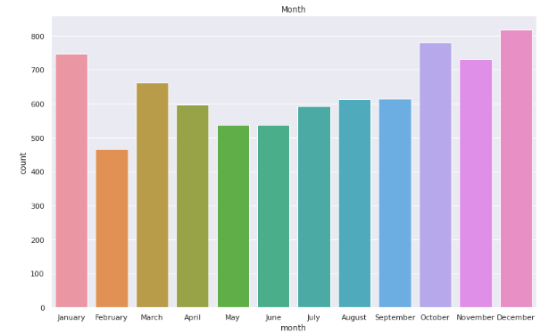
Month wise analysis of Releases movie
we can see that, In netflix maximum content added in December and minimum in february

Slide 17
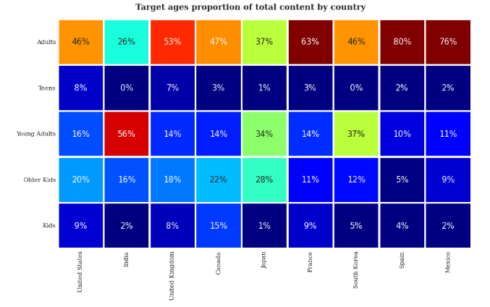
Correlation Heatmap
Available movies and tv show for different age groups in top 10 countries
This shows that the available content in different countries is maximum for adults

Slide 18
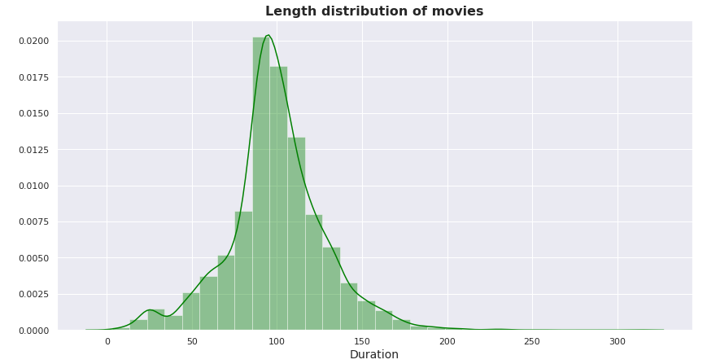
EDA Of Duration distribution of Movies
This graph shows Most of the movies last for 90 to 120 minutes

Slide 19
Data Cleaning
Label Encoding-refers to converting the labels into a numeric form so as to convert them into the machine-readable form.
Lemmatisation- Lemmatization, unlike Stemming, reduces the inflected words properly ensuring that the root word belongs to the language. In Lemmatization root word is called Lemma. ... For example, runs, running, ran are all forms of the word run, therefore run is the lemma of all these words.
Removing Stop words - To remove stop words from a sentence, you can divide your text into words and then remove the word if it exits in the list of stop words provided by NLTK.
Tf - idf Vectorization - TF-IDF stands for “Term Frequency — Inverse Document Frequency”.
This is a technique to quantify a word in documents, we generally compute a weight to each word which signifies the importance of the word in the document and corpus. This method is a widely used technique in Information Retrieval and Text Mining.
Min-max Scaling - For each value in a feature, MinMaxScaler subtracts the minimum value in
the feature and then divides by the range. It preserves shape of original distribution.

Slide 20
Topic Modeling (LDA and LSA)
Latent Semantic Analysis(LSA) is used to find the hidden topics represented by the document or text. This hidden topics then are used for clustering the similar documents together. LSA is an unsupervised algorithm and hence we don't know the actual topic of the document.
● In natural language processing, the Latent Dirichlet Allocation (LDA) is a
generative statistical model that allows sets of observations to be explained
by unobserved groups that explain why some parts of the data are similar.

Slide 21
Creating Clusters:
What is clustering?
Clustering is the task of dividing the data points into a number of groups such that data points in the same groups are more similar to other data points in the same group and dissimilar to the data points in other groups. It is basically a collection of objects on the basis of similarity and dissimilarity between them.
How to cluster similar data?
To create clusters we will use the K-Means Clustering; which is an iterative process in which the dataset is grouped into k number of predefined non-overlapping clusters or subgroups, making the inner points of the cluster as similar as possible while trying to keep the clusters at distinct space it allocates the data points to a cluster so that the sum of the squared distance between the clusters centroid and the data point is at a minimum.

Slide 22
Silhouette Score Method
Silhouette score is used to evaluate the quality of clusters created using clustering algorithms such as K-Means in terms of how well samples are clustered with other samples that are similar to each other.
Mean distance between the observation and all other data points in the same cluster. This distance can also be called a mean intra-cluster distance. The mean distance is denoted by a.
Mean distance between the observation and all other data points of the next nearestcluster. This distance can also be called a mean nearest-cluster distance. The meandistance is denoted by b.
(S = \frac{(b - a)}{max(a, b)}\)
*Using this method in our dataset we found the optimal number of cluster is equal to 3.

Slide 23
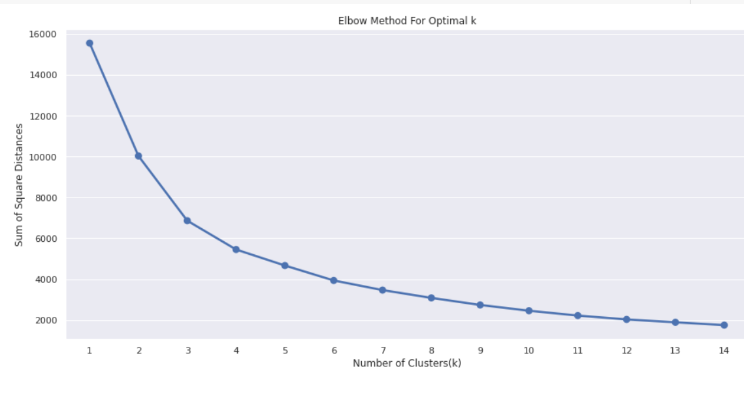
Elbow curve to find optimal value of cluster k:
The Elbow Method is one of the most popular methods to determine this optimal
value of k.
To determine the optimal number of clusters, we have to select the value of k at
the “elbow” ie the point after which the distortion/inertia start decreasing in a
linear fashion. Thus for the given data, we conclude that the optimal number of
clusters for the data is 3.

Slide 24
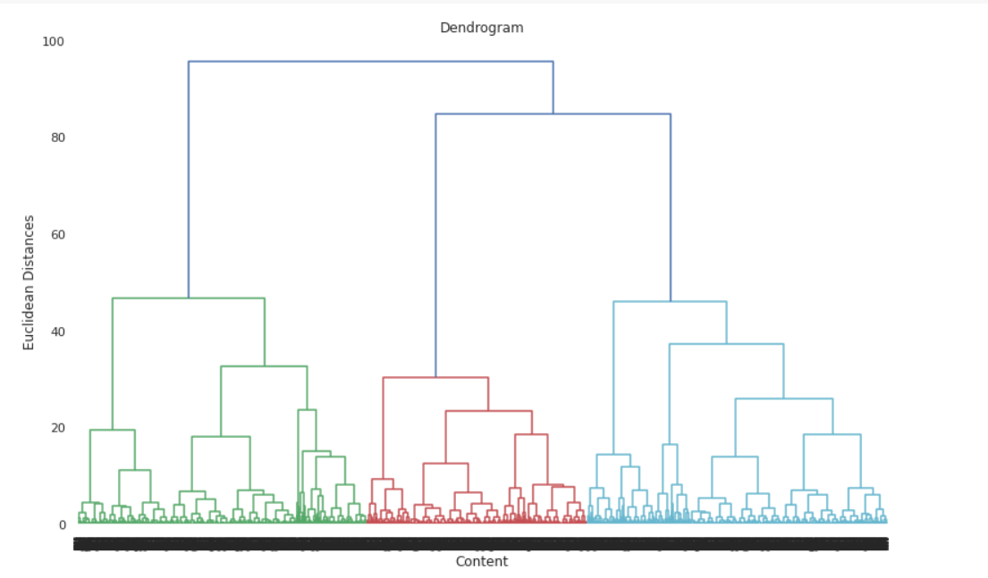
Dendogram to find the optimal number of clusters(Hierarchial Clustering)
The number of clusters will be the number of vertical lines which are being
intersected by the line drawn using the threshold
No. of Cluster = 3

Slide 25
Conclusion:
1. Data set contains 7787 rows and 12 columns in that cast and director features contains large
number of missing values so we can drop it and we have 10 feature for the further implementation
2. We have two types of content TV shows and Movies (30.86% contains TV shows and 69.14%
contains Movies)
3. Jan Suter is the most popular directors on Netflix with the most titles are mainly international as
well.
4. Anupam Kher and Sharukh Khan are the most popular actor
5. By analysing the content added over years we get to know that in recent years netflix is focusing movies than TV shows (movies is increased by 80% and TV shows is increased by 73% compare to 2016 data)

Slide 26
Conclusion(continued):
6. The most number of the movies and TV shows release in 2017 and 2020 respectively and united nation have the maximum content on netflix
7. On Netflix, Dramas genre contains the maximum content among all of the genres and the most of the content added in december month and less content in february
8. By applying the silhouette score method for n range clusters on dataset we got best score which is 0.348 for 3 clusters it means content explained well on their own clusters, by using elbow method after k = 3 curve gets linear it means k = 3 will be the best cluster
9. Applied different clustering models Kmeans, hierarchical, Agglomerative clustering on data we got the best cluster arrangments
10. By applying different clustering algorithms to our dataset .we get the optimal number of cluster is equal to 3

Slide 27
Thank You!

